Slide 1


Project Presentation on
AI BASED AYURVEDIC PLANT DIVINATION
Under the Guidance of
Presented by
Dr. Usha M.S
Associate Professor and Head
Dept. of CS & Engineering
NIEIT, Mysuru
NAVYASHREE S 4NN20CS030
PRATHEEK RAJ URS C P 4NN20CS036
VINAY PRAKASH 4NN20CS062
ASWIN MENON 4NN21CS401

Slide 2

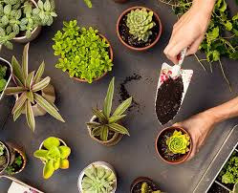

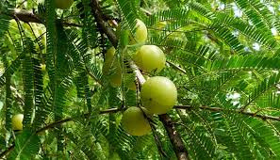
AGENDA FOR THE DAY
ABSTRACT
INTRODUCTION
LITERATURE SURVEY
PROBLEM STATEMENT
OBJECTIVES
SYSTEM REQUIREMENTS
METHODOLOGY
DESIGN
IMPLEMENTATION
TESTCASES
RESULTS
COMAPARISONS WITH EXISTING METHODS
CONCLUSION
FUTURE ENHANCEMENT
REFERENCE
CERTIFICATE

Slide 3


ABSTRACT
Our presentation introduces a groundbreaking application merging ancient Ayurvedic wisdom with cutting-edge technology. Powered by TensorFlow Lite and a Convolutional Neural Network algorithm, the app offers seamless identification of Ayurvedic plants through simple image recognition. Beyond mere identification, it provides users with detailed insights into the medicinal benefits, traditional uses, and cultural significance of each plant. Additionally, the app encourages active engagement in cultivation practices and conservation efforts, serving as a comprehensive tool for both enthusiasts and practitioners. Through this harmonious integration of traditional knowledge and modern innovation, the project aims to safeguard endangered Ayurvedic botanical treasures, ensuring their preservation for future generations.

Slide 4
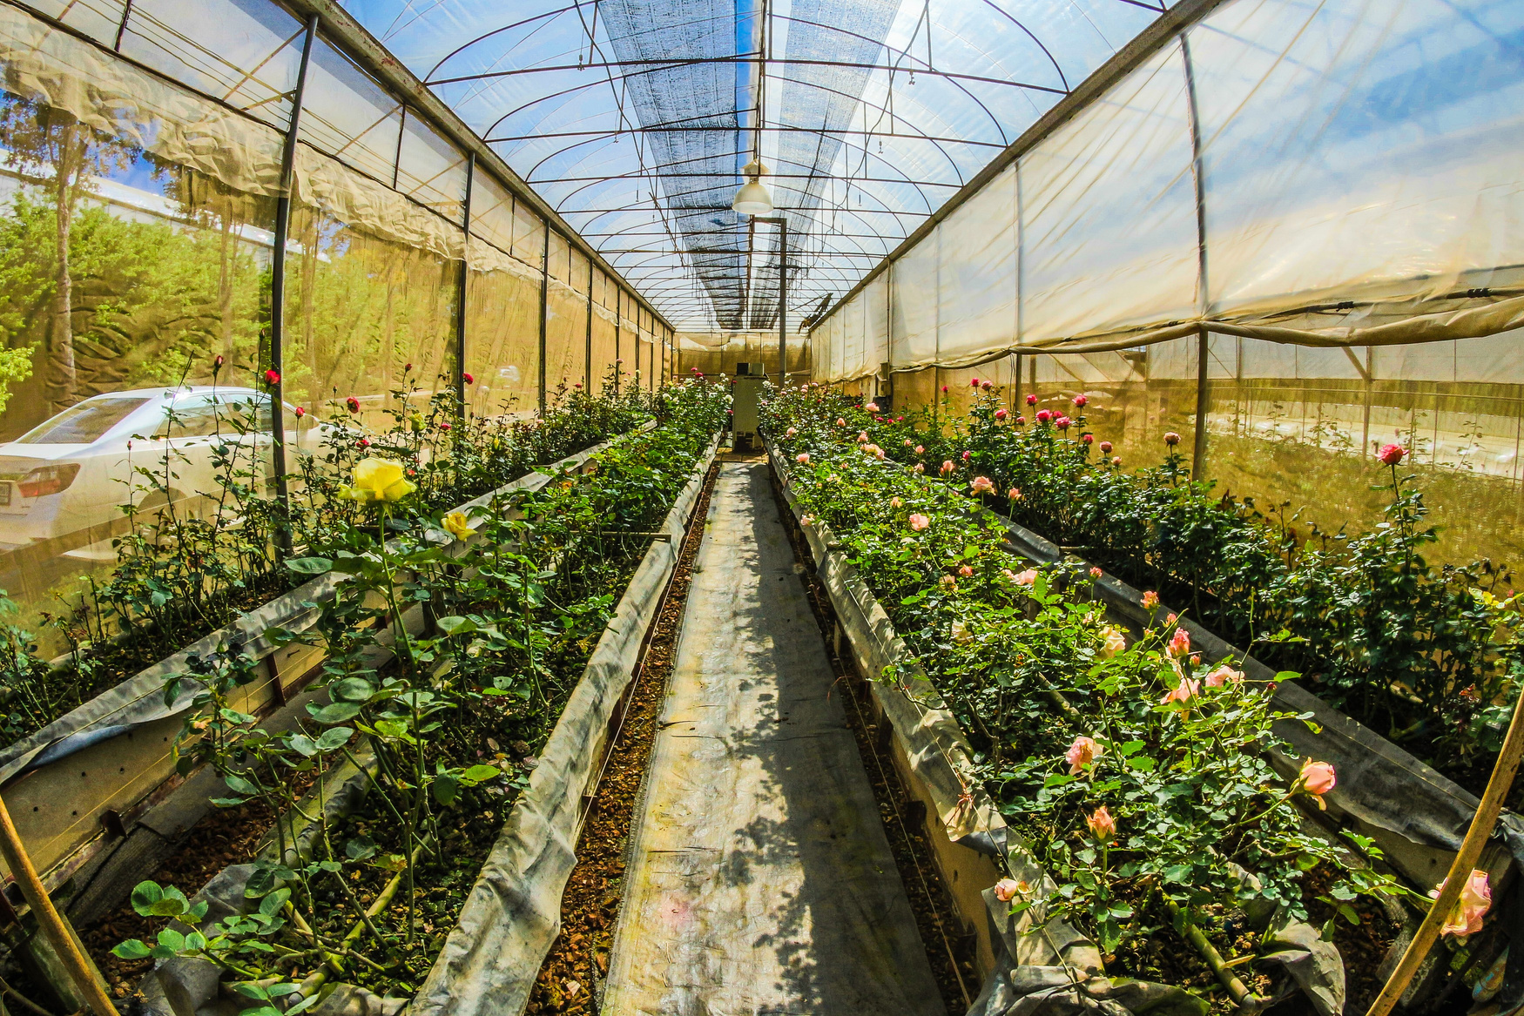
INTRODUCTION
In a world increasingly embracing holistic and natural remedies, Ayurveda, the ancient Indian system of medicine, has gained significant recognition for its use of herbs and plants to promote health and well-being.
Ayurvedic plants, with their unique medicinal properties, play a pivotal role in this traditional healing system. Recognizing and identifying these plants accurately is crucial for harnessing their therapeutic potential.
The project aims to bridge the gap between traditional wisdom and modern technology.
This innovative system leverages the power of computer vision and deep learning to empower users with the ability to identify Ayurvedic plants from a diverse group of botanical species.
Not only does it offer plant recognition, but it also provides valuable information about the uses, advantages, and Benifits associated with each detected plant.

Slide 5
LITERATURE SURVEY
TITLE | AUTHOR [JOURNAL] | YEAR | DESCRIPTION
Medleaf Detection using Image Processing Algorithm | Prof. Archana Ekbote [IJERT] | 2021 | The objective behind the papers is to eradicate this quandary, and hence strives to avail probable users make better utilization of plants with medicinal properties. The dataset consists of numerous images of variants of leaves.
An Effcient Mobile Application for Identification of Immunity Boosting Medicinal Plants using Shape Descriptor Algorithm | Ashwani Kumar Dubey [Springer] | 2023 | Leaf descriptors are analyzed based on a deep learning algorithm to iden?tify the medicinal plant. Layers of neurons are trained to classify names that describe images into classes. Deep convolutional neural networks are suitable to categorize numeric data, without knowledge of descriptor structure.
A Survey on Ayurvedic Plant Identification Using Augmented Reality | Rakshith Hegde K S, Dr Ajay Shriram Kushwaha [JETIR] | 2022 | The main features required to identify an ayurvedic plant, are its leaf shape, leaf size, color and texture. The database of the ayurvedic plants is created by scanning the leaves. Our project provides a way to identify these plantsusing the image processing technique, with the help of markers

Slide 6
Ayurvedic Plant Identification using Image Processing and Artificial Intelligence | Amey Sunil Deshmukh [IJSR] | 2021 | An efficient Ayurvedic plant leaf recognition system will beneficial to many sectors of society which include medicinal field, botanic research etc.
Identification of Medicinal Plant Using Machine Learning Approach | Nayana G. Gavhale, Dr.A.P.Thakare [IRJET] | 2020 | In this paper we have implemented a technique for medicinal plant identification using random forest algorithm, an ensemble supervise machine learning algorithm based on color, texture and geometrical features to identify the correct species of medicinal plant.
Automatic Recognition of Medicinal Plants using Machine Learning Techniques | Adams Begue, Venitha Kowlessur [IJACSA] | 2017 | Five different machine learning classifiers were used to assess the recognition rate. The results are shown in Table III. The Random Forest classifier achieves the best performance with an accuracy of 90.1%, i.e., out of 720 leaves, 649 leaves were classified correctly while 71 were not.

Slide 7
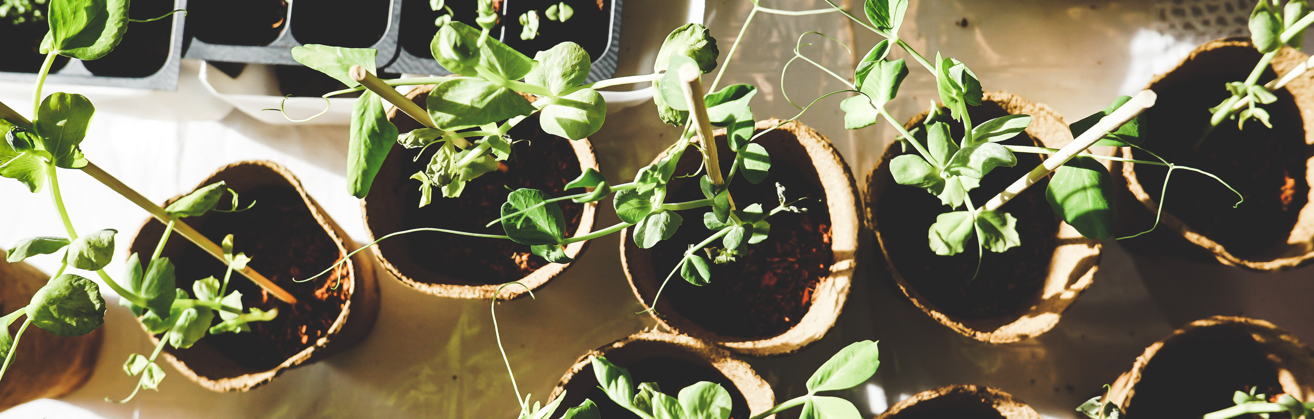
In the realm of holistic medicine and natural wellness, Ayurveda stands as an age-old beacon of traditional healing, relying heavily on the therapeutic properties of various botanical species. These Ayurvedic plants hold the key to countless health benefits, yet the identification and utilization of these potent herbs and herbs remain a challenge for many individuals, from seasoned practitioners to those new to Ayurveda.
PROBLEM STATEMENT

Slide 8
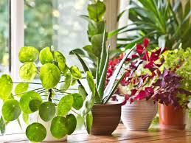
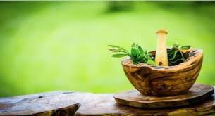
OBJECTIVES
Develop a robust deep learning model that can accurately identify Ayurvedic plants from a diverse range of plant species based on input images.
Utilize CNN algorithms to extract detailed information from textual sources about the recognized Ayurvedic plants, including their medicinal properties, uses, and cultural significance.
Design an intuitive and user-friendly interface that allows users to interact with the application easily. The interface will support image capture, upload, and result presentation with other options like health,beauty,cooking tips with benifits information.
.
Create an educational tool that provides valuable insights into Ayurvedic plants, promoting awareness and understanding of their medicinal properties

Slide 9



SYSTEM REQUIREMENTS
Platform Compatibility
Hardware Requirement
Permissions
TensorFlow Lite-python
Android Studio-kotlin
Computer-16gb
Android mobile with 32mp camera
Camera access
Storage access
Data access

Slide 10
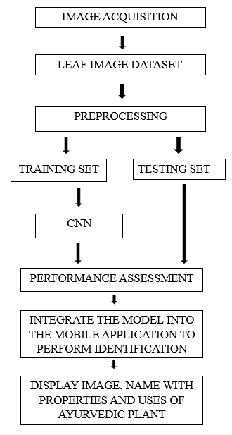
METHODOLOGY
Algorithm Selection:
The Ayurvedic plant detection app employs a Convolutional Neural Network (CNN) for precise identification of Ayurvedic plants through advanced image processing and pattern recognition
Training Datasets in TensorFlow Lite:
Ayurvedic plant datasets are trained with TensorFlow Lite, optimizing image recognition for mobile and edge devices with reduced computational load.
Integration with Android Studio:
The TensorFlow Lite-based model for Ayurvedic plant detection is smoothly incorporated into Android Studio
Frontend Image Capture with Scanner:
The user-friendly frontend features an intuitive scanner, enabling mobile users to capture Ayurvedic plant images, enhancing accessibility and engagement for an interactive and user-driven identification experience.
Image Comparison and Output:
Once an image is captured, the app compares it with the pre-trained datasets using the CNN algorithm.
The model identifies the plant based on visual features and provides users with the plant's name and useful properties.
Flow chart

Slide 11
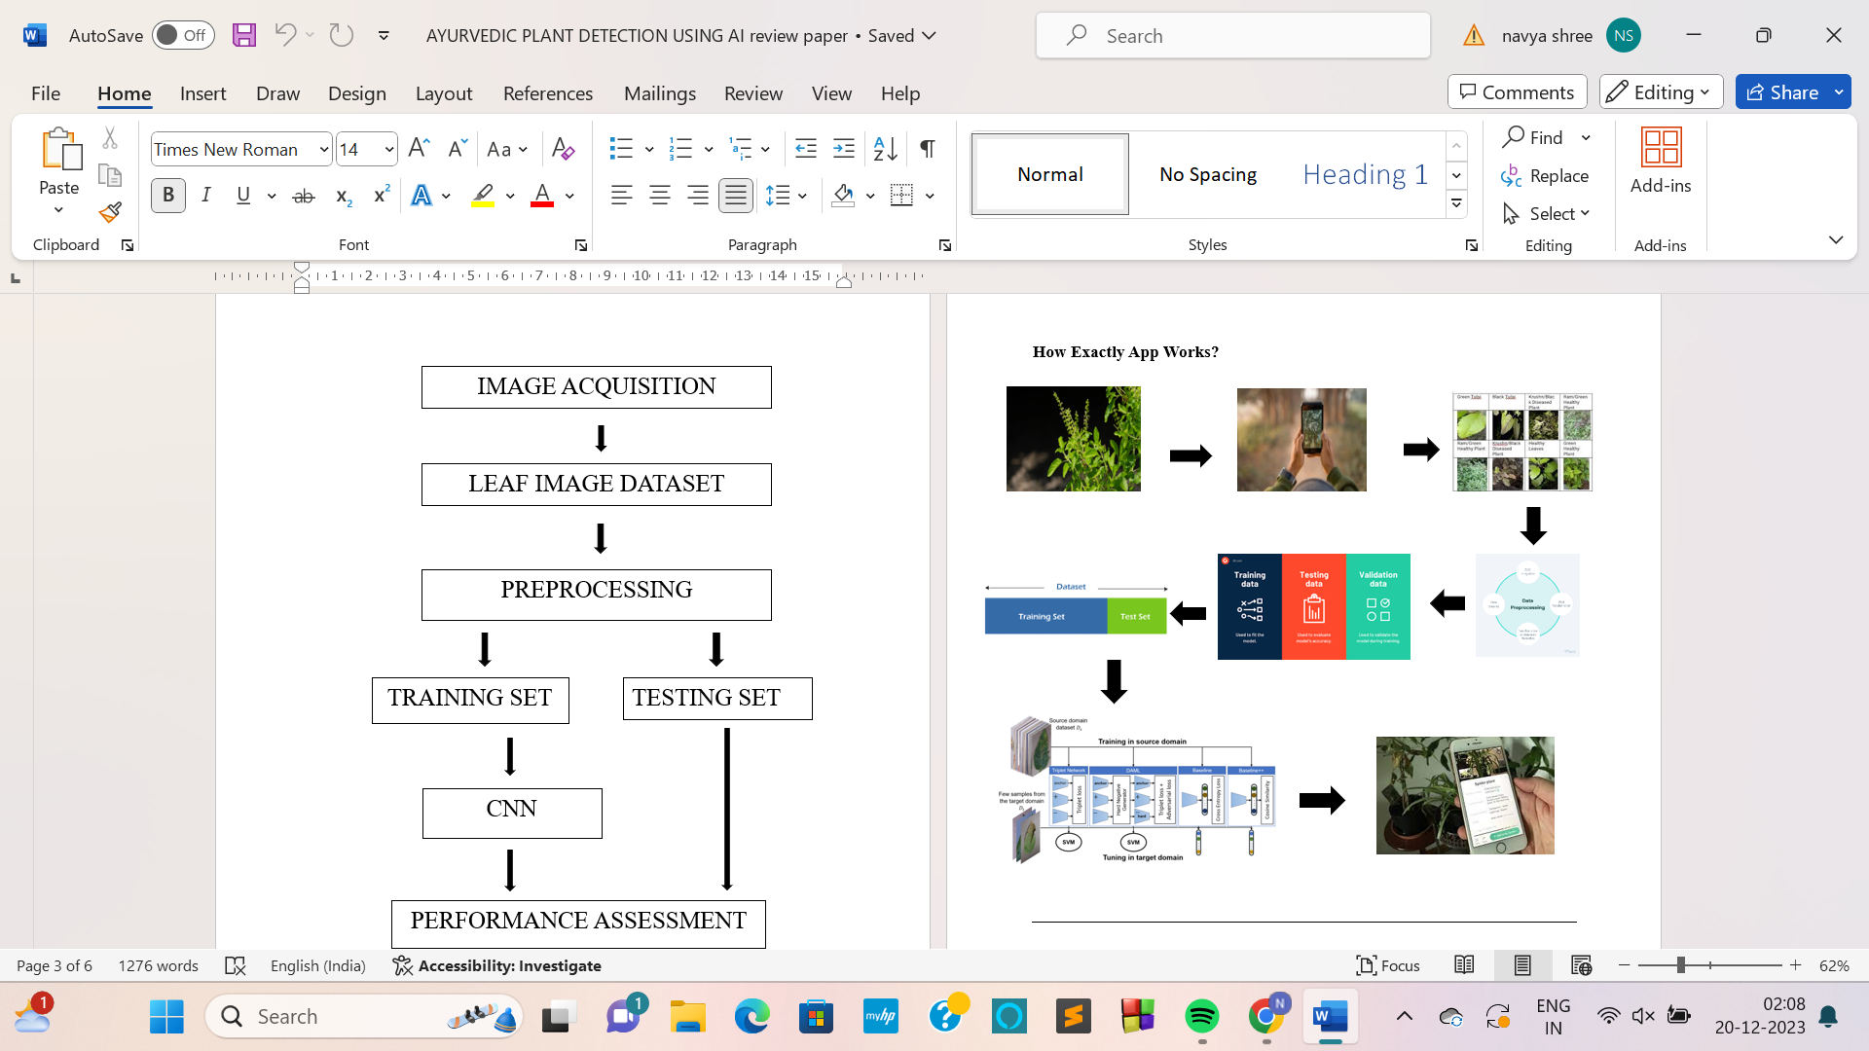

DESIGN
Image Capture and Input
TensorFlow Lite Training
CNN-Based Image Comparison
Output and Information Display

Slide 12
IMPLEMENTATION
CNN ARCHITECTURE
WORKING MECHANISM
Convolutional Layers for Image Processing
Classification and Matching Algorithm
Deep Learning for Pattern Recognition
Feature Extraction and Recognition
Integration with TensorFlow
Image Input Processing
Convolutional Layers
Pooling Layers
Fully Connected Layers
Activation Functions

Slide 13
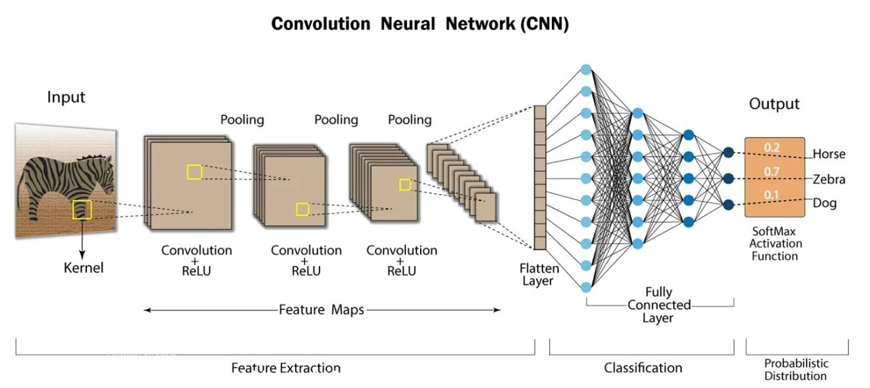

Slide 14
METHODS
TEACHABLE MACHINE
GOOGLE COLAB
TensorFlow API
MobileNet
REST API
TensorFlow API
Keras API

Slide 15
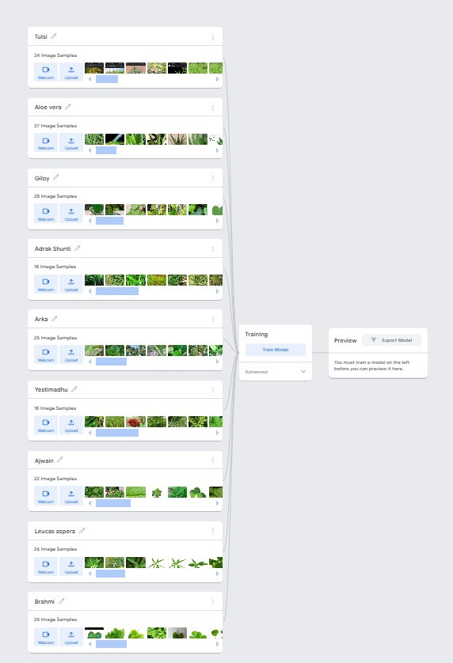

SNAPSHOTS AND DEMO

Slide 16
TEST CASES-RESULT
EXPECTED RESULT
ACTUAL RESULT
REASON FOR FAIL
SL.NO
INPUT
PASS/FAIL
1
-
TULSI
TULSI
TULSI
PASS
-
2
PASS
ALOEVERA
ALOEVERA
ALOEVERA
3
-
AJWAN
AJWAN
AJWAN
PASS
4
IT IS NOT AN AYURVEDIC PLANT
EASTER
CACTUS
EASTER
CACTUS
NOT FOUND
FAIL
5
-
ARKA
ARKA
ARKA
PASS

Slide 17
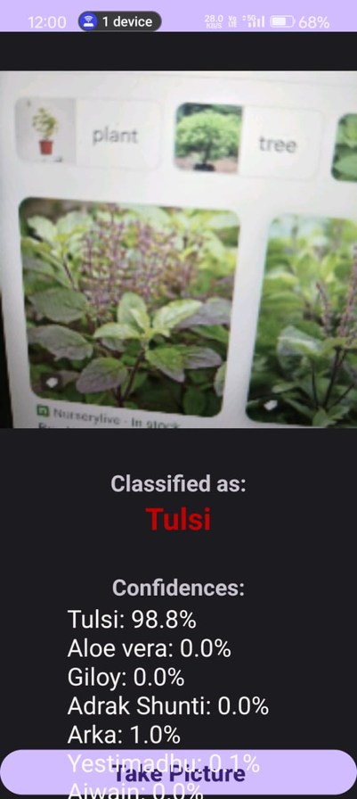
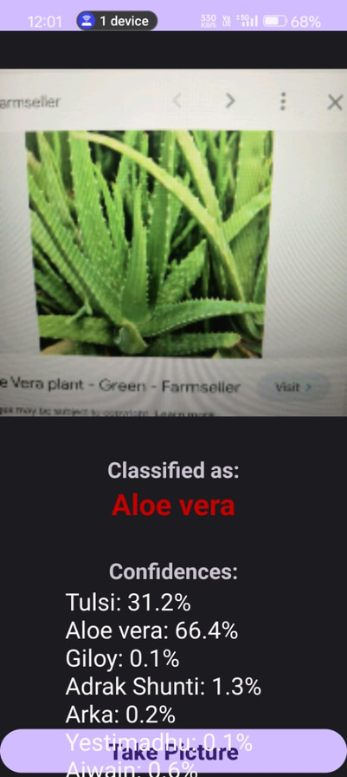
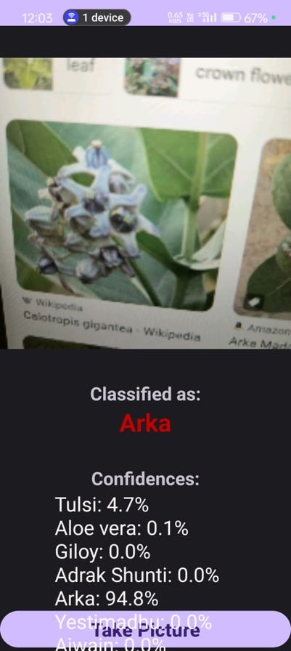
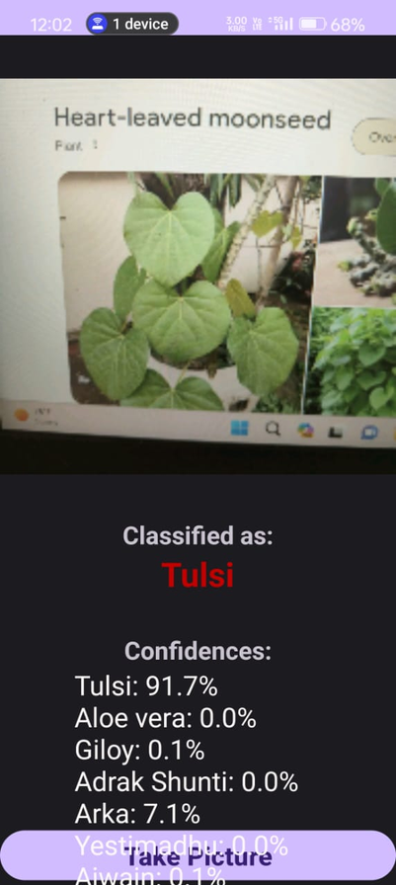
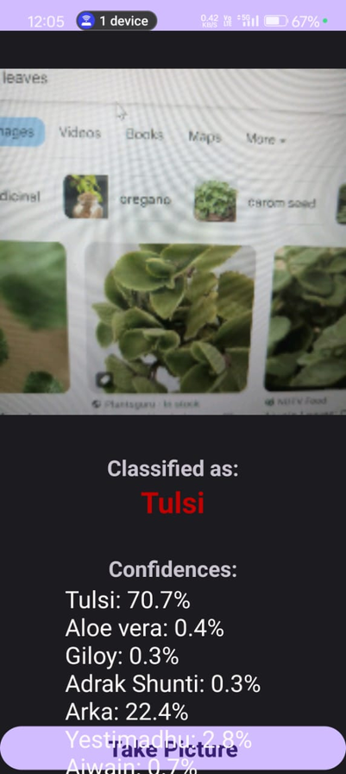
CHALLENGES CAME ACROSS IN BUILDING THE APPLICATION
USING TEACHABLE MACHINE- GOOGLE PICTURES

Slide 18
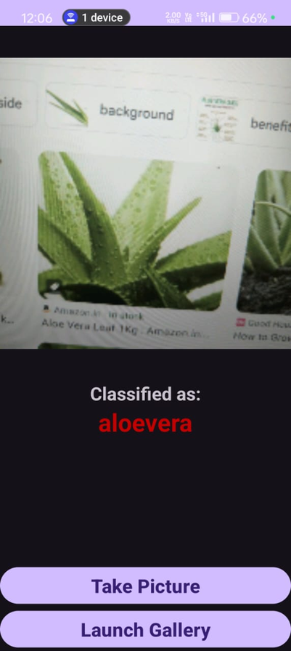
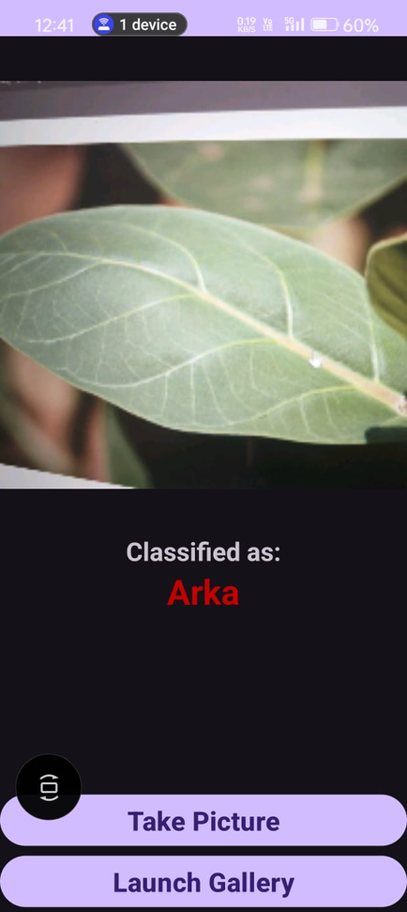
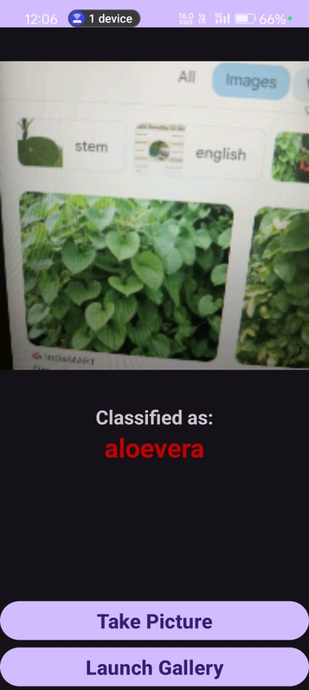
USING SINGLE LEAF RESOLUTION

Slide 19
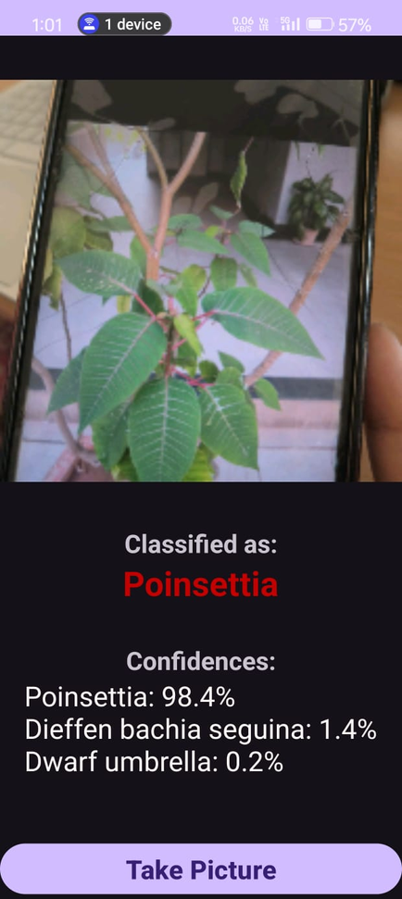
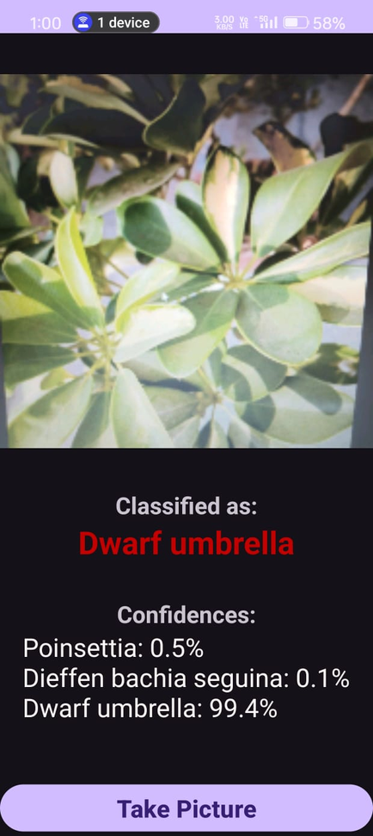
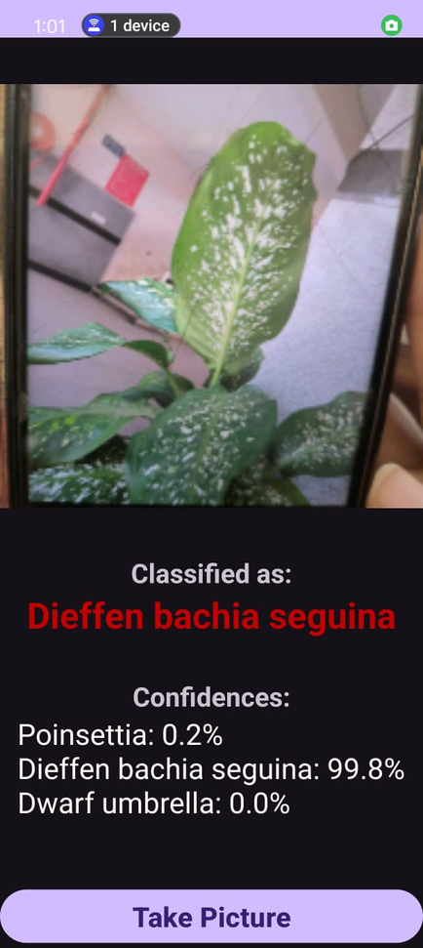
USING TEACHABLE MACHINE- HIGH RESOLUTION PICTURES

Slide 20
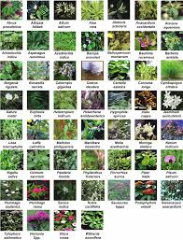
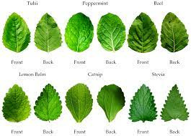
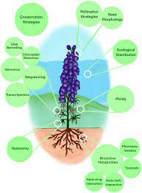
EXISTING SYSTEM(COMAPARISON)
The medicinal plants are manually identified using structural features, namely, height, shape, size of leafy part, flowers, fruits, and branching patterns
Colour and texture from both sides of the leaf contain deterministic parameters to identify the species.
Visual plant disease estimation by human raters
Microscopic evaluation
Techniques like image processing, pattern recognition
By using charts and reference books.

Slide 21
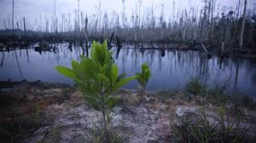
DISADVANTAGES
Limited Accuracy
Lack of Comprehensive Information
Language Barriers
Region-Specific Databases
User-Dependent Accuracy
Outdated Information
Lack of Integration
Limited Scope

Slide 22
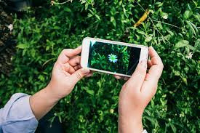

PROPOSED SYSTEM
Accurate Ayurvedic Plant Identification
Comprehensive Plant Recognition
Ayurvedic Plant Segregation
Extensive Ayurvedic Plant Database
Real-time Information Extraction
User-Friendly Interface
Educational Content
Regular Updates and Maintenance
Plant Library
Integration with Ayurvedic Databases

Slide 23
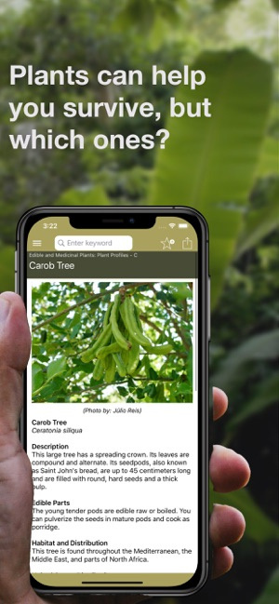
ADVANTAGES
Plant Identification
Knowledge Dissemination
Holistic Health Promotion
Accessibility
Speed and Convenience
User Enagement
Data and Model Accuracy

Slide 24

CONCLUSION
Culinary and Home Remedies
The app accurately identifies a wide variety of plants, with a specific focus on Ayurvedic plants, ensuring reliable results for users.
Users receive detailed and comprehensive information about the identified Ayurvedic plants, including their medicinal properties, uses, advantages, and benifits enhancing their knowledge base
The app engages users with educational content, fostering a deeper understanding of Ayurvedic plants, herbal medicine, and traditional healing practices, thereby promoting holistic health awareness
Promotion of Ayurvedic Knowledge
Integration with Healthcare Practices

Slide 25
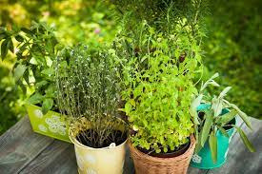

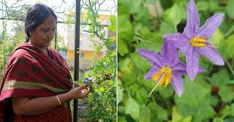
REFERENCES
Title: "Natural Language Processing in the Biomedical Domain: A Unified System Architecture Overview",Authors: K. B. Cohen, L. Hunter
Title: "A Survey on Plant Leaf Recognition Techniques"Authors: S. N. Omkar, S. Ramachandra
Title: "A Survey of Leaf Recognition Techniques"Authors: R. Senthil, R. Amirtharaja
Title: "Plant Identification Using Deep Neural Networks via Optimization of Transfer Learning Parameters"Authors: O. Avsievich, A. A. Aivazyan
Title: "Deep Plant Phenomics: A Deep Learning Platform for Complex Plant Phenotyping Tasks"Authors: W. DeChant, S. Lilavois
Google Scholar, IEEE Xplore, ResearchGate ,ChatGPT, MDPI,Springer,PubMed,ScienceDirect:,Academia.edu Sci-hub etc.
Easy ayurveda website, ayurveda dravyaguna,e-dravya apps and many books including chatgpt for database information collection

Slide 26
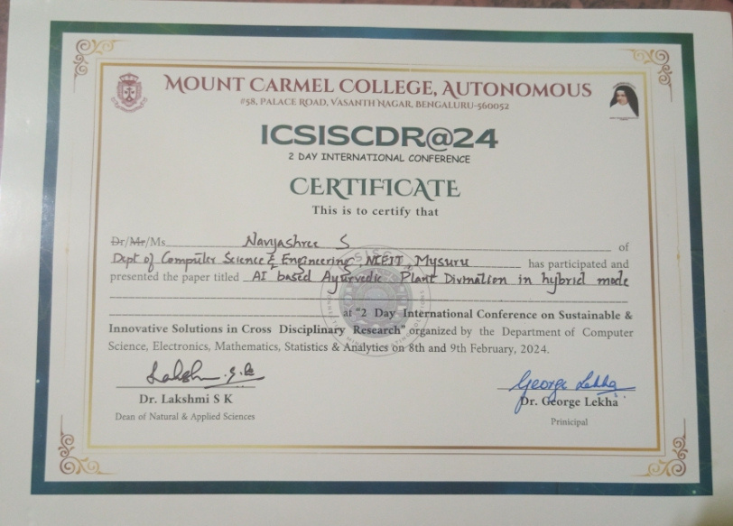
CONFERENCE CERTIFICATE

Slide 27
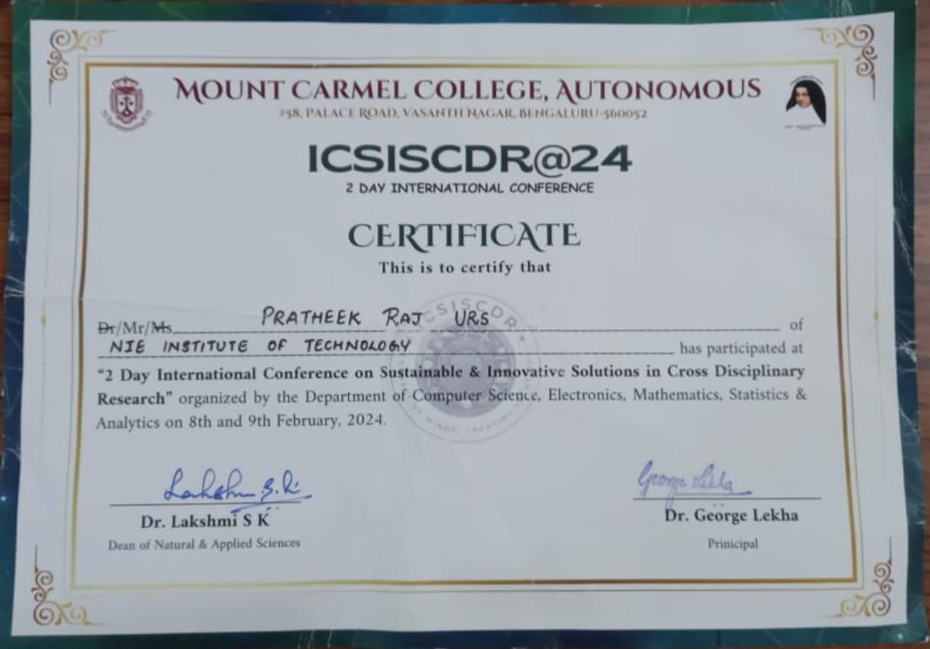

Slide 28
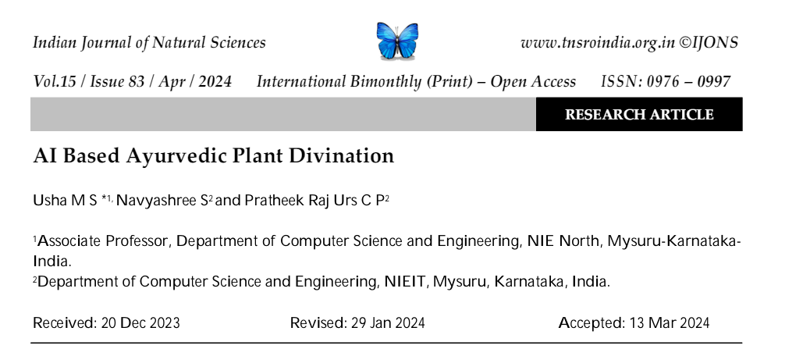
JOURNAL PAPER PUBLICATION
Our project, titled "AI-Based Ayurvedic Plant Divination," has been published in the Indian Journal of Natural Sciences, a reputable Web of Science indexed journal. This international bimonthly publication is dedicated to advancing knowledge across natural sciences.The full paper can be accessed through the following link: https://tnsroindia.org.in/journals.html

Slide 29

THANK YOU

